Slide 1
How to Build a Strategic Plan & Stick to It!
By
Head Harvesters Bill Arman & Ed Laflamme
Notes:
Bill & Fred Intro Comments:

Slide 2
Thanks to Our Sponsors
Notes:
Bill & Fred Intro Comments:

Slide 3
Notes:
Bill & Fred Intro Comments:

Slide 4
Notes:
Bill & Fred Intro Comments:

Slide 5
Notes:
Bill & Fred Intro Comments:

Slide 6
Bill Arman Ed Laflamme
Head Harvesters
Notes:
Bill & Fred Intro Comments:

Slide 7
Harvesters’ Hope for Today Affirmation Learn and Try Something New Build Framework of a Plan
How to Build a Plan
Notes:
Bill’s Slide:

Slide 8
Why Plan?
How to Build a Plan
Notes:
Bill’s Slide:

Slide 9
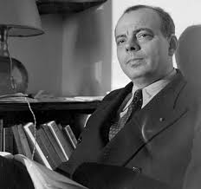
“A goal without a plan is just a wish” Antoine de Saint-Exupéry
mmm
Notes:
Bill’s Slide:

Slide 10
Why Plan? Have a “Road Map” to Success Provides Inspiration and Direction Establishes Measurable Milestones and Goals
Notes:
Bill’s Slide:

Slide 11
Why Plan? Retain & Attract the Right People Plots Your Course – Focus Your Efforts Helps Establish Cash & Capital Needs
Notes:
Bill’s Slide:

Slide 12
Why Plan? Provides Options for Plan A Creates & Sustains Alignment Team Building
Notes:
Bill’s Slide:

Slide 13
Why Plan? Employee Engagement Shared Responsibility and Accountability Helps to Avoid / Repeat Mistakes
Notes:
Bill’s Slide:

Slide 14
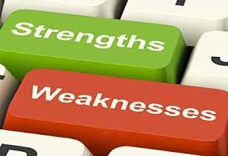
Why Plan? Learn Strengths / Weaknesses: You & Competitors Marketing & Sales Strategies Exit - Succession Planning
Notes:
Bill’s Slide:

Slide 15
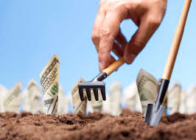
Why Plan? Grow Profitably!
Notes:
Bill’s Slide:

Slide 16
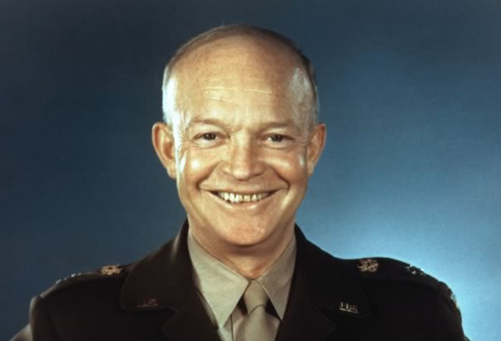
“Plans are nothing; planning is everything” Dwight D. Eisenhower
Notes:
Bill’s Slide:

Slide 17
“Every minute you spend planning saves 10 minutes in execution, this gives you a 1,000 percent Return on Energy!” Brian Tracy
Notes:
Bill’s Slide:

Slide 18
“No Plan, No Way!” Head Harvesters Bill & Ed
Notes:
Bill’s Slide:

Slide 19
Why Don’t We Plan?
Notes:
Bill’s Slide:

Slide 20
Too Busy - No Time - Shiny Objects
Why Don’t We Plan?
Notes:
Bill’s Slide:

Slide 21
We do plans . . . then forget about them.
Why Don’t We Plan?
Notes:
Bill’s Slide:

Slide 22
Things Change “Too Fast” to Plan
Why Don’t We Plan?
Notes:
Bill’s Slide:

Slide 23
We’d rather react than pro-act It’s just more exciting!
Why Don’t We Plan?
Notes:
Bill’s Slide:

Slide 24
We Have a Plan … Ready Shoot Aim! (Usually Right in the . Ouch!)
Why Don’t We Plan?
Notes:
Bill’s Slide:

Slide 25
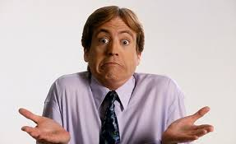
We Don’t Know How!
Why Don’t We Plan?
Notes:
Bill’s Slide:

Slide 26
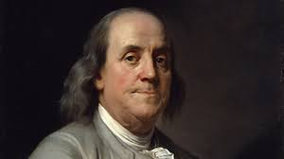
“You can’t plow a field simply by turning it over in your mind.” Benjamin Franklin
mmm
Notes:
Bill’s Slide:

Slide 27
Today’s Plan Six Steps for Building a Strategic Plan & Sticking to It!
Notes:
Bill’s Slide:

Slide 28
#1: Planning Preparation #2: Planning Session Fundamentals #3: The “Here” to “There” Premise #4: Key Elements of a Plan #5: Putting the Plan Together #6: Execution of the Plan
Six Steps for Building a Plan
Notes:
Bill’s Slide:

Slide 29
Step One Planning Preparation
Notes:
Bill’s Slide:

Slide 30
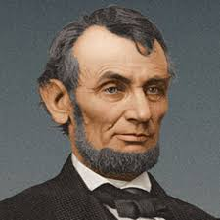
“Give me six hours to chop down a tree and I will spend the first four hours sharpening the axe.” Abraham Lincoln
mmm
Notes:
Bill’s Slide:

Slide 31
When to Hold Planning Meetings
Planning Preparation
Notes:
Bill’s Slide:

Slide 32
Deciding Who Attends
Planning Preparation
Notes:
Bill’s Slide:

Slide 33
Where to Hold Planning Session
Planning Preparation
Notes:
Bill’s Slide:

Slide 34
How Long Should It Be
Planning Preparation
Notes:
Bill’s Slide:

Slide 35
“Practice the 1% Rule.” Head Harvester Ed
Notes:
Bill’s Slide:

Slide 36
Facilitate or Not to Facilitate
Planning Preparation
Notes:
Bill’s Slide:

Slide 37
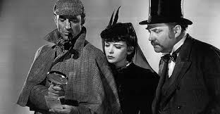
Fact Finding - Financials - Sales
Planning Preparation
Notes:
Bill’s Slide:

Slide 38
Fact Finding Example: Sales Revenue Stream - Size - Market Type - GM - Tenure
Planning Preparation
Notes:
Bill’s Slide:

Slide 39
Trends – Environmental Scan
Planning Preparation
Notes:
Bill’s Slide:

Slide 40
Review Last Plan
Planning Preparation
Notes:
Bill’s Slide:

Slide 41
Agenda
Planning Preparation
Notes:
Bill’s Slide:

Slide 42
Any Prep Needed by Attendees
Planning Preparation
Notes:
Bill’s Slide:

Slide 43
Survey Team Members & Customers
Planning Preparation
Notes:
Bill’s Slide:

Slide 44
Step One Planning Preparation Thoughts – Questions – Comments?
Notes:
Bill’s Slide:

Slide 45
Step Two Planning Fundamentals
Notes:
Bill’s Slide:

Slide 46
Have an Agenda Start & End on Time
Planning Fundamentals
Notes:
Bill’s Slide:

Slide 47
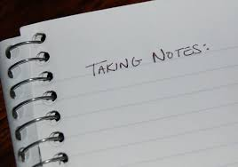
Record Notes - Ideas - Action Items
Planning Fundamentals
Notes:
Bill’s Slide:

Slide 48
Establish Rules of Engagement
Planning Fundamentals
Notes:
Bill’s Slide:

Slide 49
Practice Open Dialogue Spirit of Inquiry
Planning Fundamentals
Notes:
Bill’s Slide:

Slide 50
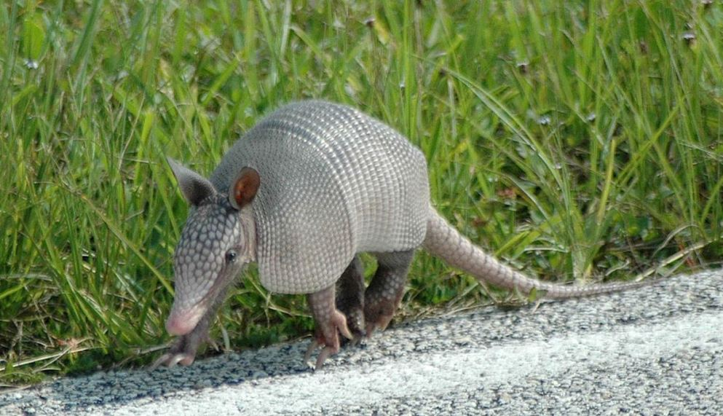
Don’t Take the Road to Abilene
Planning Fundamentals
Notes:
Bill’s Slide:

Slide 51
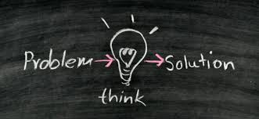
Practice 90-10 Rule Focus on Solutions-Not the Problem
Planning Fundamentals
Notes:
Bill’s Slide:

Slide 52
Have Consensus Building
Planning Fundamentals
Notes:
Bill’s Slide:

Slide 53
Establish Rules of Engagement
Planning Fundamentals
Notes:
Bill’s Slide:

Slide 54
Decide on Top / High Leverage Priorities
Planning Fundamentals
Notes:
Bill’s Slide:

Slide 55
Link Priorities to Measurable Goals
Planning Fundamentals
Notes:
Bill’s Slide:

Slide 56
Do a Debrief of Planning Session
Planning Fundamentals
Notes:
Bill’s Slide:

Slide 57
Sleep On It!
Planning Fundamentals
Notes:
Bill’s Slide:

Slide 58
Step Two Planning Fundamentals Thoughts - Questions - Comments
Notes:
Bill’s Slide:

Slide 59
Step Three The “Here” to “There” Premise
Notes:
Bill’s Slide:

Slide 60
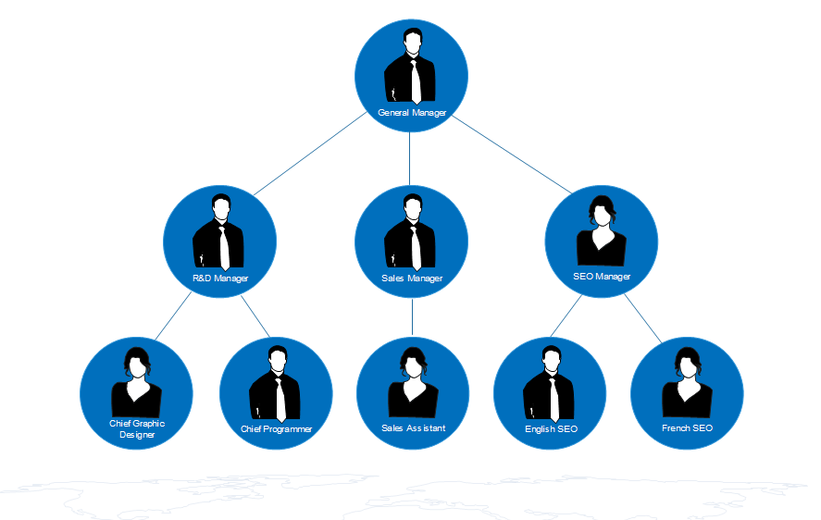
Establish “Here” Revenue Gross Margins People Map – Org Chart
The “Here” to “There” Premise
Notes:
Bill’s Slide:

Slide 61
Establish “Here” in Key Metrics
The “Here” to “There” Premise
Notes:
Bill’s Slide:

Slide 62
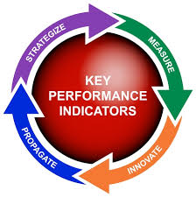
Review Performance in Key Metrics
The “Here” to “There” Premise
Notes:
Bill’s Slide:

Slide 63
___ Revenue: Overall & By Stream ___ Gross Margin: Overall & By Stream ___ Net Profit ___ Safety ___ Customer Retention ___ Customer Penetration % with Extras ___ Key Employee Retention ___ Internal Quality Standards ___ Accounts Receivable
The “Here” to “There” Premise Exercise
“Here” Key Metrics Rating
Notes:
Bill’s Slide:

Slide 64
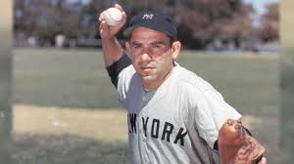
“If you don’t know where you are going, you might end up somewhere else.” Yogi Berra
Notes:
Bill’s Slide:

Slide 65
Next Project “There” 3-5 Years Out
The “Here” to “There” Premise
Notes:
Bill’s Slide:

Slide 66
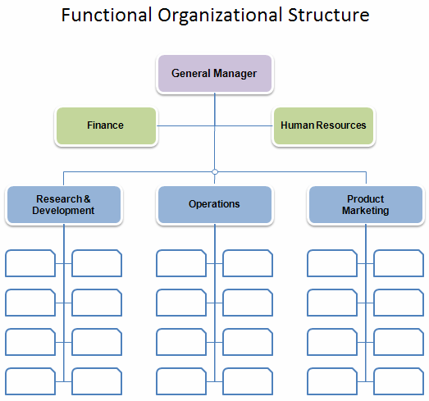
Establish “There” Revenue Gross Margins People Map - Org Chart
The “Here” to “There” Premise Exercise
Notes:
Bill’s Slide:

Slide 67
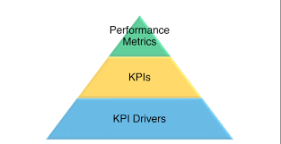
Establish “There” Desired Performance in Key Metrics
The “Here” to “There” Premise
Notes:
Bill’s Slide:

Slide 68
Revenue Gross Margin Net Profit Safety Customer Retention Customer Penetration Key Employee Retention Internal Quality Standards Accounts Receivable
The “Here” to “There” Premise Exercise
Establish “There” Key Metric Goals
Notes:
Bill’s Slide:

Slide 69
“Here” ------- Key Metrics ------- “There” Revenue Revenue Gross Margin Gross Margin People Map People Map Key Metrics Key Metrics
The “Here” to “There” Premise
Notes:
Bill’s Slide:

Slide 70
Step Three The “Here” to “There” Premise Thoughts – Questions - Comments
Notes:
Bill’s Slide:

Slide 71
Step Four Key Elements of a Plan
Notes:
Bill’s Slide:

Slide 72
Culture Vision – Mission – Core Values – Success Behaviors
Key Elements of a Plan
Notes:
Bill’s Slide:

Slide 73
Marketing – Sales
Key Elements of a Plan
Notes:
Bill’s Slide:

Slide 74
Customers
Key Elements of a Plan
Notes:
Bill’s Slide:

Slide 75
People
Key Elements of a Plan
Notes:
Bill’s Slide:

Slide 76
Financials
Key Elements of a Plan
Notes:
Bill’s Slide:

Slide 77
Operations
Key Elements of a Plan
Notes:
Bill’s Slide:

Slide 78
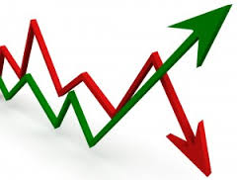
Trends – Environmental Scan
Key Elements of a Plan
Notes:
Bill’s Slide:

Slide 79
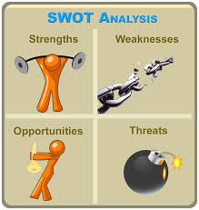
SWOTT! Yourselves & Competitors
Key Elements of a Plan
Notes:
Bill’s Slide:

Slide 80
Technology - Innovation
Key Elements of a Plan
Notes:
Bill’s Slide:

Slide 81
Best Practices-Programs-Processes
Key Elements of a Plan
Notes:
Bill’s Slide:

Slide 82
Lessons Learned: Brags/ Bloopers
Key Elements of a Plan
Notes:
Bill’s Slide:

Slide 83
Secondary: Basic “To Do” Stuff
Key Elements of a Plan
Notes:
Bill’s Slide:

Slide 84
Step Four Key Elements of a Plan Thoughts – Questions – Comments
Notes:
Bill’s Slide:

Slide 85
Step Five Putting the Plan Together
Notes:
Bill’s Slide:

Slide 86
“A goal without a plan is just a wish.” Antoine de Saint - Exupéry
mmm
Notes:
Bill’s Slide:

Slide 87
List All Areas Initiatives to be Considered
Putting the Plan Together
Notes:
Bill’s Slide:

Slide 88
Link All Areas - Initiatives to Key Metrics
Putting the Plan Together
Notes:
Bill’s Slide:

Slide 89
Build Priority Map -Blind Vote Boil Down
Putting the Plan Together
Notes:
Bill’s Slide:

Slide 90
Decide on Top 1-3 Key High Leverage Areas
Putting the Plan Together
Notes:
Bill’s Slide:

Slide 91
The ONE THING
Putting the Plan Together
Notes:
Bill’s Slide:

Slide 92
Decide 1-3 Secondary Areas
Putting the Plan Together
Notes:
Bill’s Slide:

Slide 93
List Simple, Easy “Fix It” Items
Putting the Plan Together
Notes:
Bill’s Slide:

Slide 94
Decide Champions & Co-Champions
Putting the Plan Together
Notes:
Bill’s Slide:

Slide 95
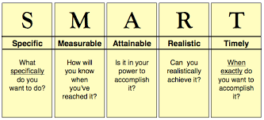
Establish SMART Goals
Putting the Plan Together
Notes:
Bill’s Slide:

Slide 96
Have Time & Measurable Milestones
Putting the Plan Together
Notes:
Bill’s Slide:

Slide 97
Establish Sequencing – Next Steps
Putting the Plan Together
Notes:
Bill’s Slide:

Slide 98
Critical: Between Now and Next 30 Days
Putting the Plan Together
Notes:
Bill’s Slide:

Slide 99
Urgent: Within 90 Days
Putting the Plan Together
Notes:
Bill’s Slide:

Slide 100
Important: Within One Year
Putting the Plan Together
Notes:
Bill’s Slide:

Slide 101
Long Range: Two – Five Years
Putting the Plan Together
Notes:
Bill’s Slide:

Slide 102
Step Five Putting the Plan Together Thoughts – Questions -Comments
Notes:
Bill’s Slide:

Slide 103
Step Six Execution of the Plan
Notes:
Bill’s Slide:

Slide 104
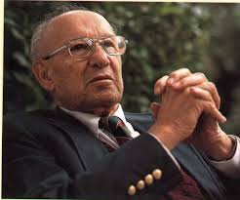
“Unless commitment is made . . . there are only promises and hopes; But No Plans.” Peter F. Drucker
Notes:
Bill’s Slide:

Slide 105
Have Plan in Writing Copies to Key People The PLAYBOOK
Execution of the Plan
Notes:
Bill’s Slide:

Slide 106
Assigned Teams with Champions
Execution of the Plan
Notes:
Bill’s Slide:

Slide 107
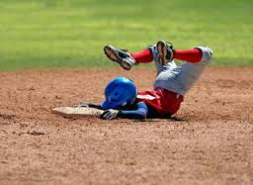
Regular “Touch Base” Meetings
Execution of the Plan
Notes:
Bill’s Slide:

Slide 108
Review Progress – Measure Results
Execution of the Plan
Notes:
Bill’s Slide:

Slide 109
Adjust When Needed or Circumstances Dictate
Execution of the Plan
Notes:
Bill’s Slide:

Slide 110
Step Six Execution of the Plan Thoughts – Questions – Comments
Notes:
Bill’s Slide:

Slide 111
Summary
How to Build a Strategic Plan and Stick to It!
Notes:
Bill’s Slide:

Slide 112
Know & Follow the Six Steps
How to Build a Strategic Plan and Stick to It!
Summary
Notes:
Bill’s Slide:

Slide 113
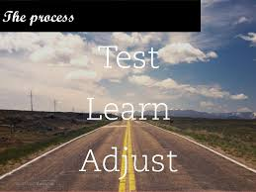
Learn and Adjust
How to Build a Strategic Plan and Stick to It!
Summary
Notes:
Bill’s Slide:

Slide 114
Link Actions to Key Results
How to Build a Strategic Plan and Stick to It!
Summary
Notes:
Bill’s Slide:

Slide 115
Measure Progress
How to Build a Strategic Plan & Stick to It!
Summary
Notes:
Bill’s Slide:

Slide 116
Engage - Enlist - Enroll
How to Build a Strategic Plan and Stick to It!
Summary
Notes:
Bill’s Slide:

Slide 117
Celebrate!
How to Build a Strategic Plan and Stick to It!
Summary
Notes:
Bill’s Slide:

Slide 118
Harvester’s Hope for Today Affirmation Learn and Try Something New Build Framework of a Plan
How to Build a Strategic Plan and Stick to It!
Notes:
Bill’s Slide:

Slide 119
Thoughts – Questions – Comments bill@harvestlandscapeconsulting.com ed@harvestlandscapeconsulting.com
How to Build a Strategic Plan & Stick to It!
Notes:
Bill’s Slide:

